Slide 1
Stanningley Primary School MindMate Lessons: information for parents
S
© Leeds South and East CCG
Notes:
These slides are designed to be shown to parents to explain the SEMH curriculum you are delivering via the MindMate Lessons. They could be shown as part of an event to engage parents such as a ‘Welcome to…’ or in a designated session. They could also be adapted and then hosted on your website.

Slide 2
What is mental health?
If we are mentally healthy are we happy all the time?
No sometimes we need to feel uncomfortable feelings
What happens if our uncomfortable feelings are there all the time?
This is when we could have mental health problems
How common are mental health problems?
1 in 4 adults and 1 in 10 children will have a mental health problem at some time in their life
Can you name any mental health problems?
2 common mental health problems are depression and anxiety
Notes:
This is a very short Q&A session which aims to highlight the fact that mental health problems are relatively common and thus to reduce stigma.

Slide 3
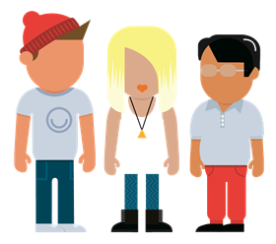
Why are the lessons so important?
We want everyone to be able to talk about how they feel
1 in 10 pupils will have a mental health problem at some point
Good mental health in childhood leads to less mental illness in adults
Working together parents and school staff can help children build resilience, manage their emotions and have a happy and healthy life
Notes:
This slide sets out the aims of the lessons

Slide 4
Why is it important to have good mental health?
Children with good mental health are better at:
Managing their behaviour
Coping with difficult situations and life changes
Doing well at school
Making and keeping friends
Doing well at sports and hobbies
Notes:
If parents are unsure of the value of the lessons this sets them out in ways which they will relate to.

Slide 5
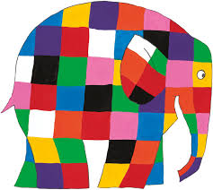
What is Mindmate? What will pupils do in the lessons?
MindMate is:
A series of 6 lessons per year aimed at improving children’s mental health and wellbeing
Watch videos
Talk in pairs
Learn about their feelings
See familiar faces such as Disney and cartoon characters
Practice ways of helping themselves and others
Copyright © 2017 Andersen Press
Notes:
Here are some of the things that children will be doing in the lessons. The lessons are all age approprite and younger pupils will be using well known characters such as Elmer to help them relate to the concepts.

Slide 6
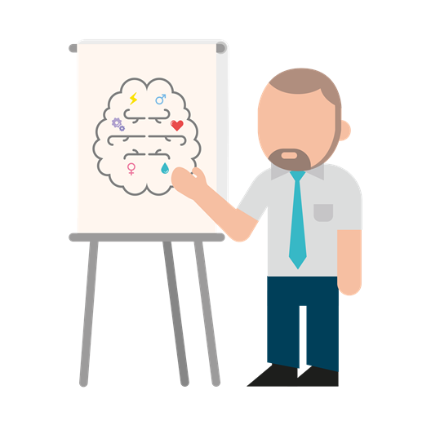
How will the lessons help?
They will teach skills, such as self awareness, to help pupils look after themselves and support their friends
They will explore life changes and healthy relationships
They will help pupils to see what they are good at and set goals in areas they need to improve

Slide 7
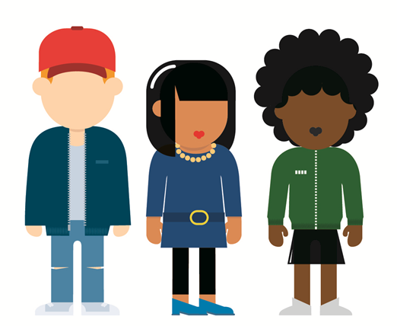
How will children be kept safe?
Each lesson will begin with a reminder of the class’s ground rules.
The teacher will explain the importance of confidentiality.
Particularly vulnerable pupils will be treated sympathetically and warned of sensitive issues before the lessons
With very sensitive topics pupils will use videos, stories and role play
The content will be age appropriate; with very young children looking at very simple concepts such as naming feelings and making friends
Notes:
The aim of this slide is to answer any concerns parents might have about the lessons before they are voiced. You might also want to talk about other PSHE RSE content and how that is handled to reassure parents that you are confident you can handle things sensitively.

Slide 8
Additional resources and help
Talk to your teacher or an adult in school
Talk to your Mum, Dad or someone you trust at home about how you are feeling
If you have them: – Write your worry down and post it in the class worry box – Talk to a Stanningley problem solver in the school playground
Contact:
www.mindmate.org.uk
Where can I go for help?
8
Notes:
Explain this is the last slide that pupils see every lesson so that they can get additional support if they need it.

